Slide 1
Face-recognition based door locking system with OTP verification
Presented by:
Aagaman K.C.
Ajay Panta
Chandra Kamal Singh
Gaurav Bhujel

Slide 2
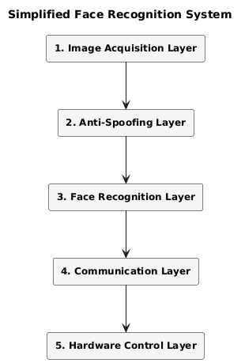
Introduction
Facial recognition based door locking system provide alternative to conventional door locking system by leverages anti-spoofing facial detection for opening door with OTP verification.
Utilizing multi-layered system including anti-spoofing layer, facial recognition layer , communication and hardware control layer which make this system very modular, dynamic and easy to control

Slide 3
Problem statement
🔓 Security Vulnerability: Traditional locks and passwords are prone to duplication and guessing.
🎭 Spoofing Threat: Face recognition alone can be fooled using printed images or video replays.
📶 Scalability Limitation: Standalone systems lack network access, limiting remote control and updates.
🌐 Lack of Cloud Integration: Without a backend server (like Django), it's hard to scale or manage data centrally.

Slide 4
🎯Objectives
🕵️‍♂️ Real-Time Facial Recognition
🛡️ Robust Anti-Spoofing
🔐 Secure Two-Factor Authentication (OTP)
⚙️ Scalable Backend Architecture
🎨 Intuitive User Interface

Slide 5
LITERATURE REVIEW
D. S. Rajavel, M. Santhoshkumaar, and S. D., “Face recognition-based door locking system with OTP verification”, Apr. 2024, India
Feature | Paper [1] | Your Project
Anti-Spoofing | ❌ Not available | ✅ Silent-Face Anti-Spoofing (Fourier + CNN)
Face Recognition | HOG (OpenCV) | DLIB / CNN-based models
OTP Integration | GSM module | Django backend (more flexible and scalable)
Logging | Excel file | Centralized database
Scalability | Limited | Scalable (modular, network-based)
Voice Feedback | ✅ APR9600 | ❌ Not implemented

Slide 6
LITERATURE REVIEW
Saputra, A. W. Dimas Ricky. "Home Door Security System with Face Recognition Using ESP32-CAM."Nigeria
Feature | Paper [2] | Your Project
Face Recognition | Eigenfaces + PCA | DLIB / CNN-based (more robust and modern)
Anti-Spoofing | ❌ Not implemented | ✅ Silent-Face Anti-Spoofing (Fourier + CNN)
Authentication Method | Face recognition only | Face + OTP (Two-factor authentication)
Backend | Local Python/OpenCV on Raspbian | Django backend (scalable, networked)
Network Integration | Limited, local Wi-Fi only | API-based access via Django (cloud-capable,scalable)

Slide 7
LITERATURE REVIEW
Burruel-Zazueta, et al. “Biometric Lock with Facial Recognition Implemented with 2 Deep Learning Techniques.”, 2024, Mexico.
Feature | Paper Project | Our Project
Face Recognition | FaceNet CNN | CNN with FFT
Anti-Spoofing | Basic methods (blinking detection, thermal camera suggested) | Advanced Fourier transform + CNN model for spoof detection
Hardware | Jetson Nano microcomputer (GPU), IMX219 Camera, Arduino UNO | ESP32-CAM , Django server, Arduino
Cloud Integration | Mostly local processing on Jetson Nano | Django server provide more control

Slide 8
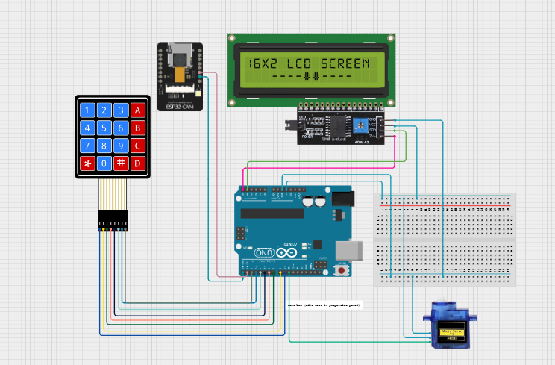
Project implementation

Slide 9
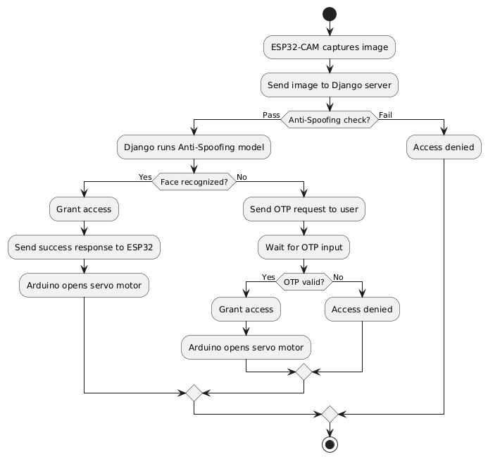
Project implementation

Slide 10
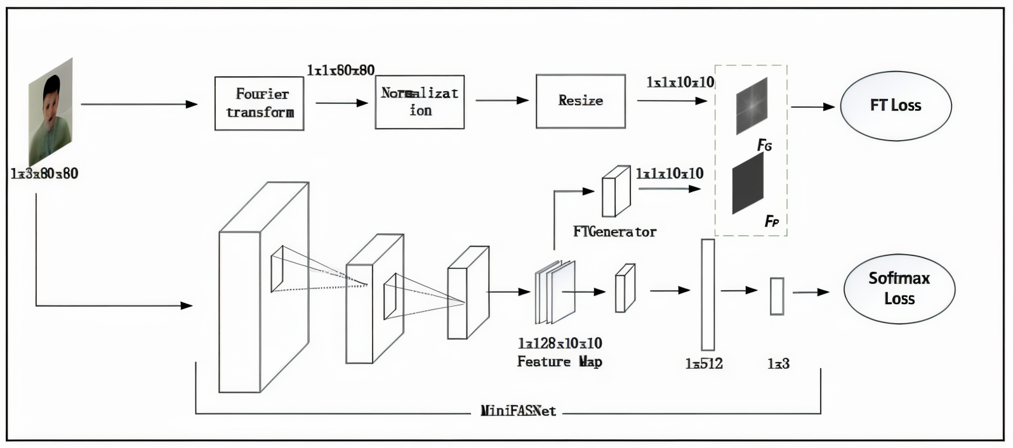
Anti-spoof Model by zhuyingSeu

Slide 11
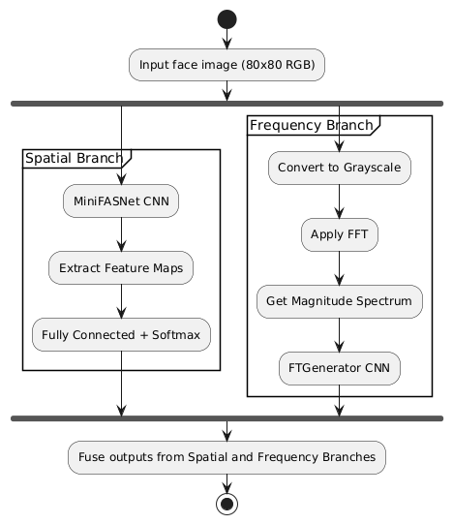
Anti-spoof Model

Slide 12
Anti-spoof Model
Advantage of this model
CNN based image classifier with cross entropy error for back tracking
Parallel Fast Fourier transform based classifier
13000 dataset were taken to train this model
CNN (spatial 2D) is better than PCA method or ANN(both flaten 1D)
FLOPs | Speed (ms) | FPR | TPR
84M | 20ms | 1e-5(0.001%) | 97.8%

Slide 13
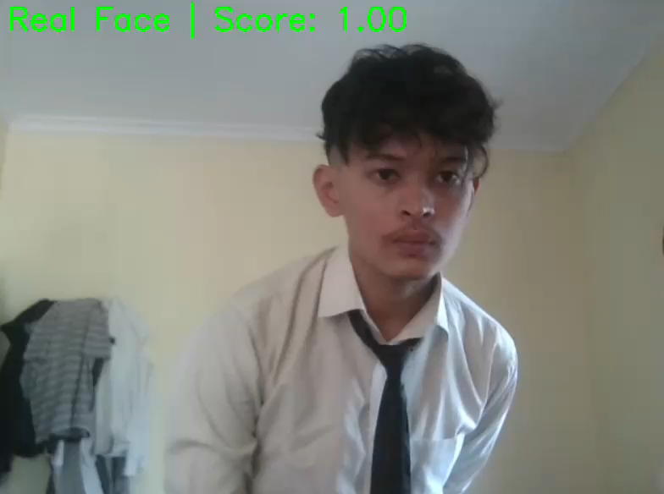
Sample Output

Slide 14
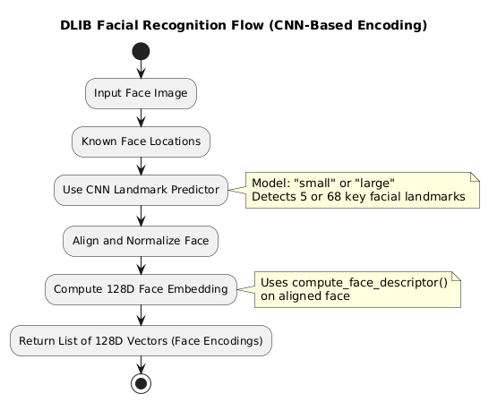
Facial Recognition Model by DLIB

Slide 15
DLIB (ResNet-34) Face Recognition model
Advantages of Dlib CNN Face Recognition Model
CNN classifier with softmax cross-entropy for robust training
Industry Standard Open-source service
Trained on ~3 million images with 7,485 identities
Outputs 128-D embeddings for accurate face representation
FLOPs | Speed (ms)* | FPR | TPR
~500M | ~35ms | ~0.6% (0.006) | ~99.4%

Slide 16
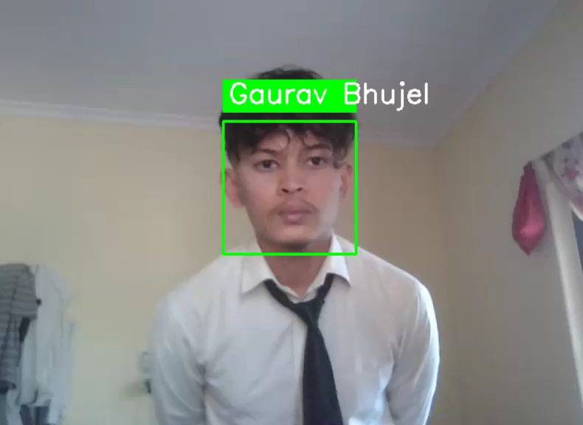
Sample output

Slide 17
🚀Major Highlight of the project
☁️ Cloud Integration
All the project done in smart door locking system so far integrate the recognition model uploaded in hardware itself (from Literature review)
Remote cloud system store models for each hardware system include
Face registered
Name, facial encoding, unique Id, and image of each face
Telegram chat ID and bot token
.
🖥️ Interactive User Interface (UI)
User can register face from the web-app for their system
OTP is send in telegram message in real-time

Slide 18
🚀Major Highlight of the project
📈 Scalability
Centralized Network Control
All face recognition device can be controlled through centralized server
🎯 Highly Accurate Model
97.8% accuracy in anti-spoof model and 99% accuracy in facial recognition model

Slide 19
Limitation
🌤️ Fairly good lighting condition
Mitigation: OTP utilization
🌐 Network Dependency
Require very stable connection due to 2 way communication betweensystem to server and server to system
Mitigation: Can be solved by Master password
⚡ Real-time processing load
Cloud server or service provider need have high processing power for real-time update

Slide 20
Future Scope
Cloud Deployment
Mobile app control
Offline Resilience

Slide 21
Reference
D. S. Rajavel, M. Santhoshkumaar, and S.D., “Face recognition-based door lockingsystem with OTP verification”, Apr. 2024,India
Saputra, A. W. Dimas Ricky. "Home DoorSecurity System with Face RecognitionUsing ESP32-CAM."Nigeria
Burruel-Zazueta, José Misael, Héctor Rodríguez-Rangel, Gloria Ekaterine Peralta-Peñuñuri, Vicenç Puig Cayuela, Ignacio Algredo-Badillo, and Luis Alberto Morales-Rosales. "Biometric Lock with Facial Recognition Implemented with Deep Learning Techniques." Computer Science and Information Systems, vol. 21, no. 4, 2024, pp. 1359–1387.

Slide 22
Project Demonstration

